Slide 1
Stock Trading with Reinforcement Learning
Zeyu Chen, Manish Kumar

Slide 2
Executive Summary
Utilization of reinforcment learning for stock trading
Examination using AAPL over ~12 years of training data and ~1 year of testing data
Agenda:
Discussion of trading environments: states, transitions, rewards and steps
Application across various approaches varying in algorithmic complexity
Performance comparison, additional application and conclusion
Experiment | Libraries Utilized | Algorithms
#1 | Custom built (leveraged anytrading) + ta | Q-Learning
#2 | gym-anytrading + StableBaselines3 | A2C , DQN
#3 | FinRL | A2C, DDPG, PPO

Slide 3
Section #1: Custom Trading Environment + Q-Learning

Slide 4
Data Processing and Technical Indicators
Data preparation
Formatting: Convert dates to pandas datetime format
Technical indicators as state variables
Technical Indicators Overview
Stochastic Oscillator
Relative Strength Index (RSI)
MACD (Moving Average Convergence Divergence)
Bollinger Bands
Commodity Channel Index (CCI)
Directional Movement Index (DX)
Simple Moving Averages (SMA)
Ten buckets to convert from continuous to discrete space variables for experiments #1 and #2
Continuous state-space for FinRL

Slide 5
States Overview
Sequential time series data with algorithm driven based on index location
States based on combinations of variables / indicators
Performance based on day shifted percentage changes
Daily data
Adjusted stock price
Technical indicators
Bucketed technical indicators as state variables
Sequential time series where next date is the next state
Long-only / “in” or “out” of the market…buy reward is one day shifted percentage change in stock price. Sell reward is zero

Slide 6
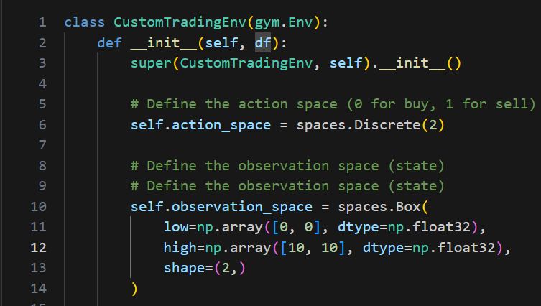
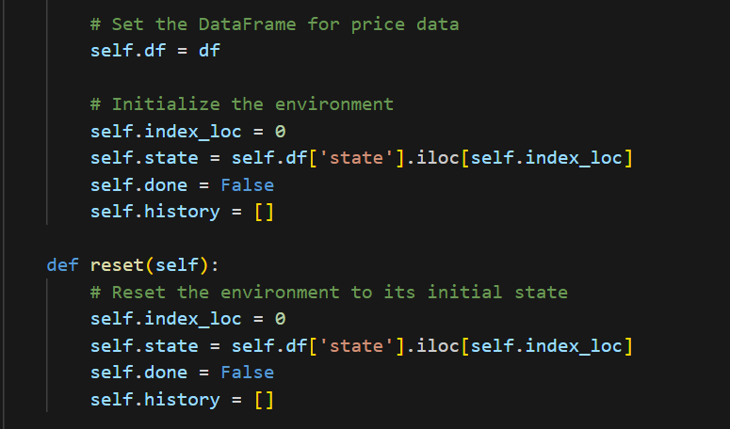
Simplified Trading Environment Overview (1 of 2)
General Setup
0: Buy and 1: Sell action space
Ten buckets for states
Start at first index location
State driven by index location

Slide 7
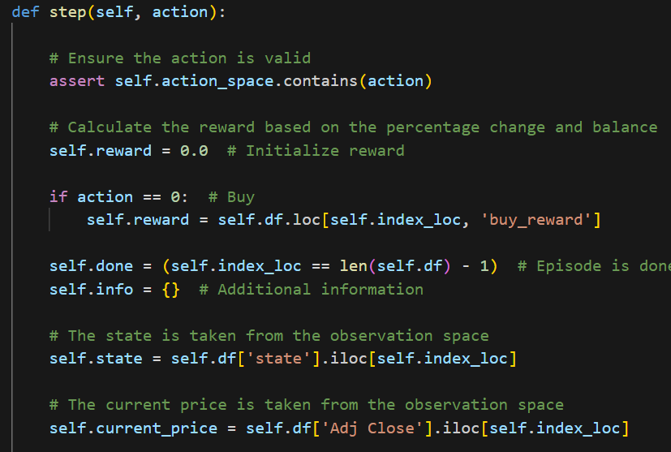
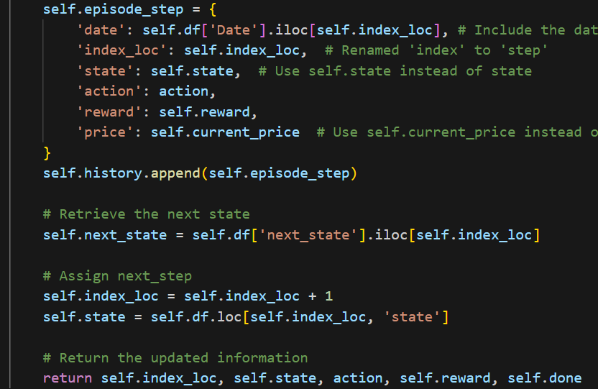
Simplified Trading Environment Overview (2 of 2)
Steps
Long-only model with reward driven by buy / sell ‘signal’
Move down the index and select the next state
Return data for reinforcement learning
Stop at last index location

Slide 8
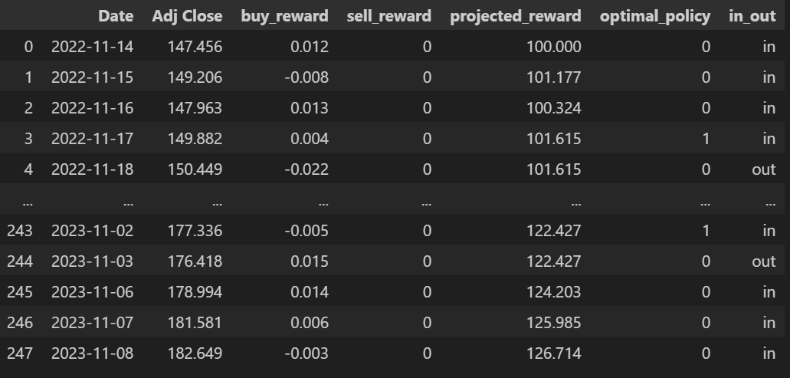
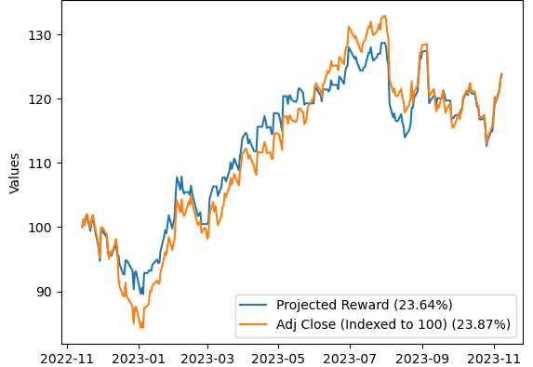
Q-Learning: Performance calculation and results
Application of the optimal policy from Q-learning – no holdout dataset
Episodes & steps_per: 10 & 2,000 / epsilon (non-greedy): 0.10 / alpha (learning rate): 0.35 / gamma: 0.99
Value calculation formula accounts for in / out status
Performance
“in_out” status based on action taken at the end of the prior state
Note: fee estimate of 0.0001 applied to rewards at sale

Slide 9
Section #2: gym-anytrading + StableBaselines3

Slide 10
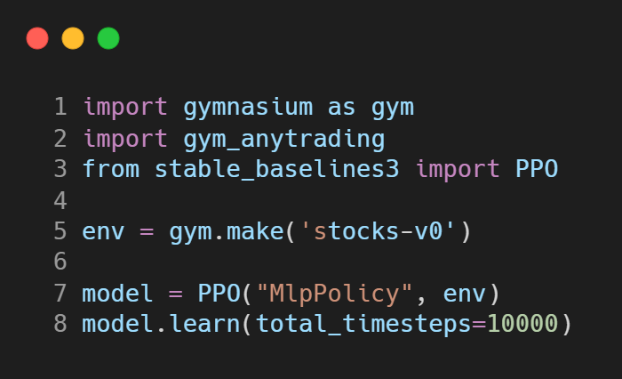
Library Overview
StableBaselines3
A set of RL algorithms implemented in PyTorch
Offers a unified structure for a wide range of RL algorithms
Predefined policies for each model
gym-anytrading
A collection of OpenAI Gym environments for RL-based trading algorithms
Offers two Gym environments: ForexEnv and StocksEnv

Slide 11
Environment Setup
Actions : Buy (1) and Sell (0)
Indicators : RSI, SMI (Discreet space of 10)
Trading Fee (Buy/Sell) : 0.1%
Prices : Adjusted Close
Reward : Price difference between trades
Training Data : 12 years (Nov 2010 – Nov 2022)
Testing Data : 1 year (Nov 2022 – Nov 2023)

Slide 12
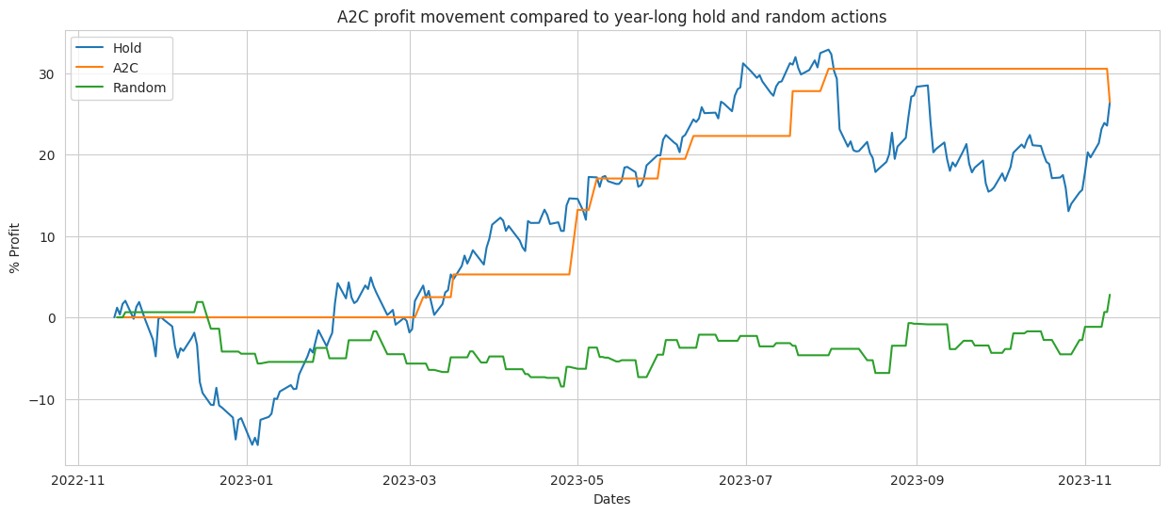
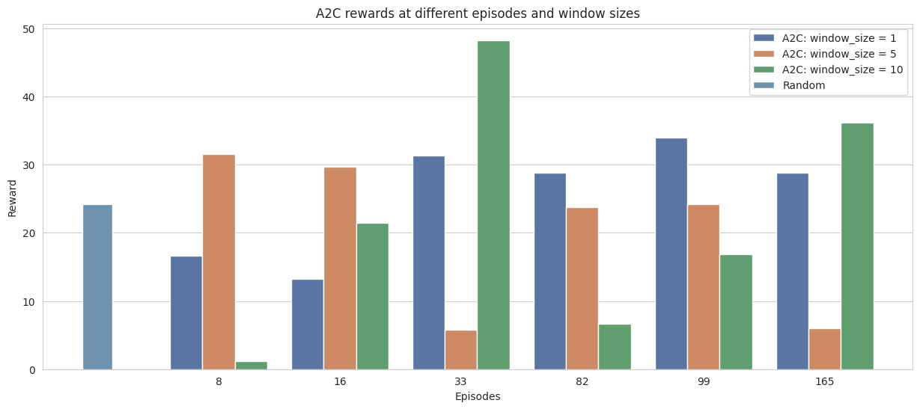
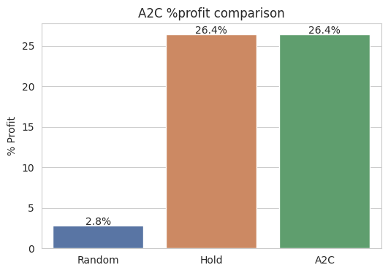
A2C: Advantage Actor-Critic
Actor: Policy-based; decides what action to take
Critic: Value-based; critiques the action that the Actor selected, provides feedback on how to adjust
Advantage: How much better an action is compared to the average action at a given state
Hyperparameters - policy: MlpPolicy, α: 5e-4, γ: 0.99

Slide 13
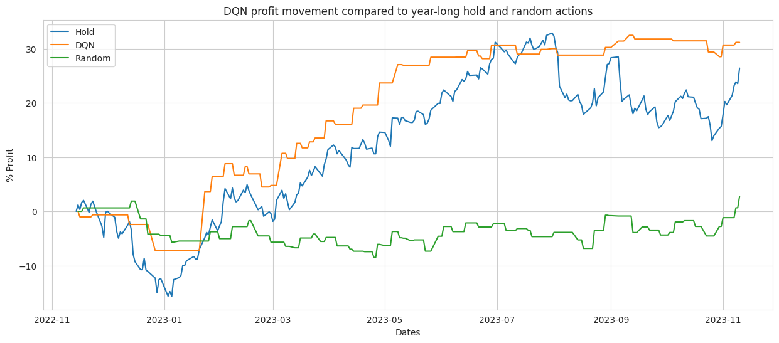
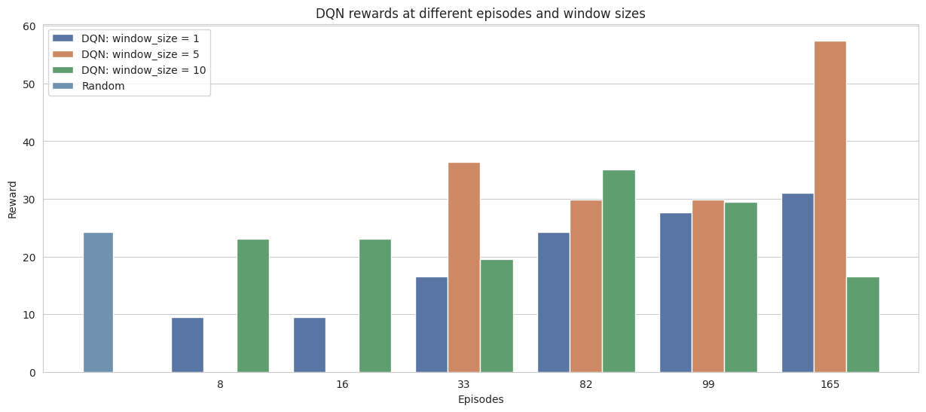
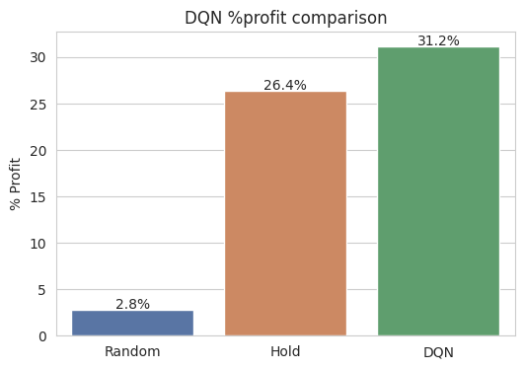
DQN: Deep Q-Learning
Combines traditional Q-learning with deep neural networks
Can learn optimal policies for high-dimensional and complex environments
Hyperparams - policy: MlpPolicy, α: 1e-4, batch_size: 32, γ: 0.99

Slide 14
Section #3: Trading in FinRL

Slide 15
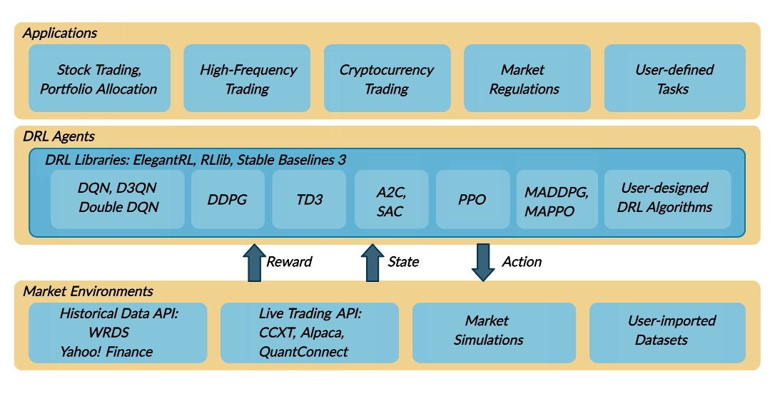
FinRL: Overview
Why FinRL
Open source library that specify for finance based of OpenAI Gym
Easy integration with ElegentRL and Stablebaseline
Ensemble trading agents training
Explorability with portfolio allocation
Three layer architecture that link to real financial/crypto data
Notes:
We want to explore more opportunities when trading with reinforcement learning agents, mostly to explore with continuous actions, meaning that we want to control how much we buy/sell for each state. To achieve this, we took at a look into a open source trading platform called FinRL, it is built based on OpenAI Gym that specializes in finance and trading. We chose this platform due to several reasons, first of all, the environment is built with continuous action space that allow the trader to trade with shares across all the stocks in the portfolio. Then, it incorporates easy integration with common rl packages such as stablebaseline that allow the trade/user to train with ease. Additionally, it provides opportunities to explore ensemble agents and trading portfolios, which makes FinRL a more realistic environment

Slide 16
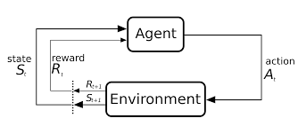
Training Environment
Training Duration: 200,000 Timesteps
Model Selection: A2C, PPO, DDPG
Reward: Change in Account Value
Max Shares per Transaction: 100 shares
Training Budget: $ 1 million
Transaction Fee: $0.001 per stock
Action Space: Continuous between -1 and 1, represent the proportion of max shares
State Space: Continuous Space of Market information with added technical indicators
Notes:
Then for the training environment of rl itself, we select the training steps to be 200,000 timesteps. According to finrl documentation, the action space of the setup is a continuous space between -1 and 1, which represents the percentage of the max shares that are bought or sold in this particular day and spread across the stocks in the portfolio, which makes it a continuous space, the reward is the change in account value. And the state space is a continuous space with dimension of the number of stocks by the select indicators plus traditional market info

Slide 17
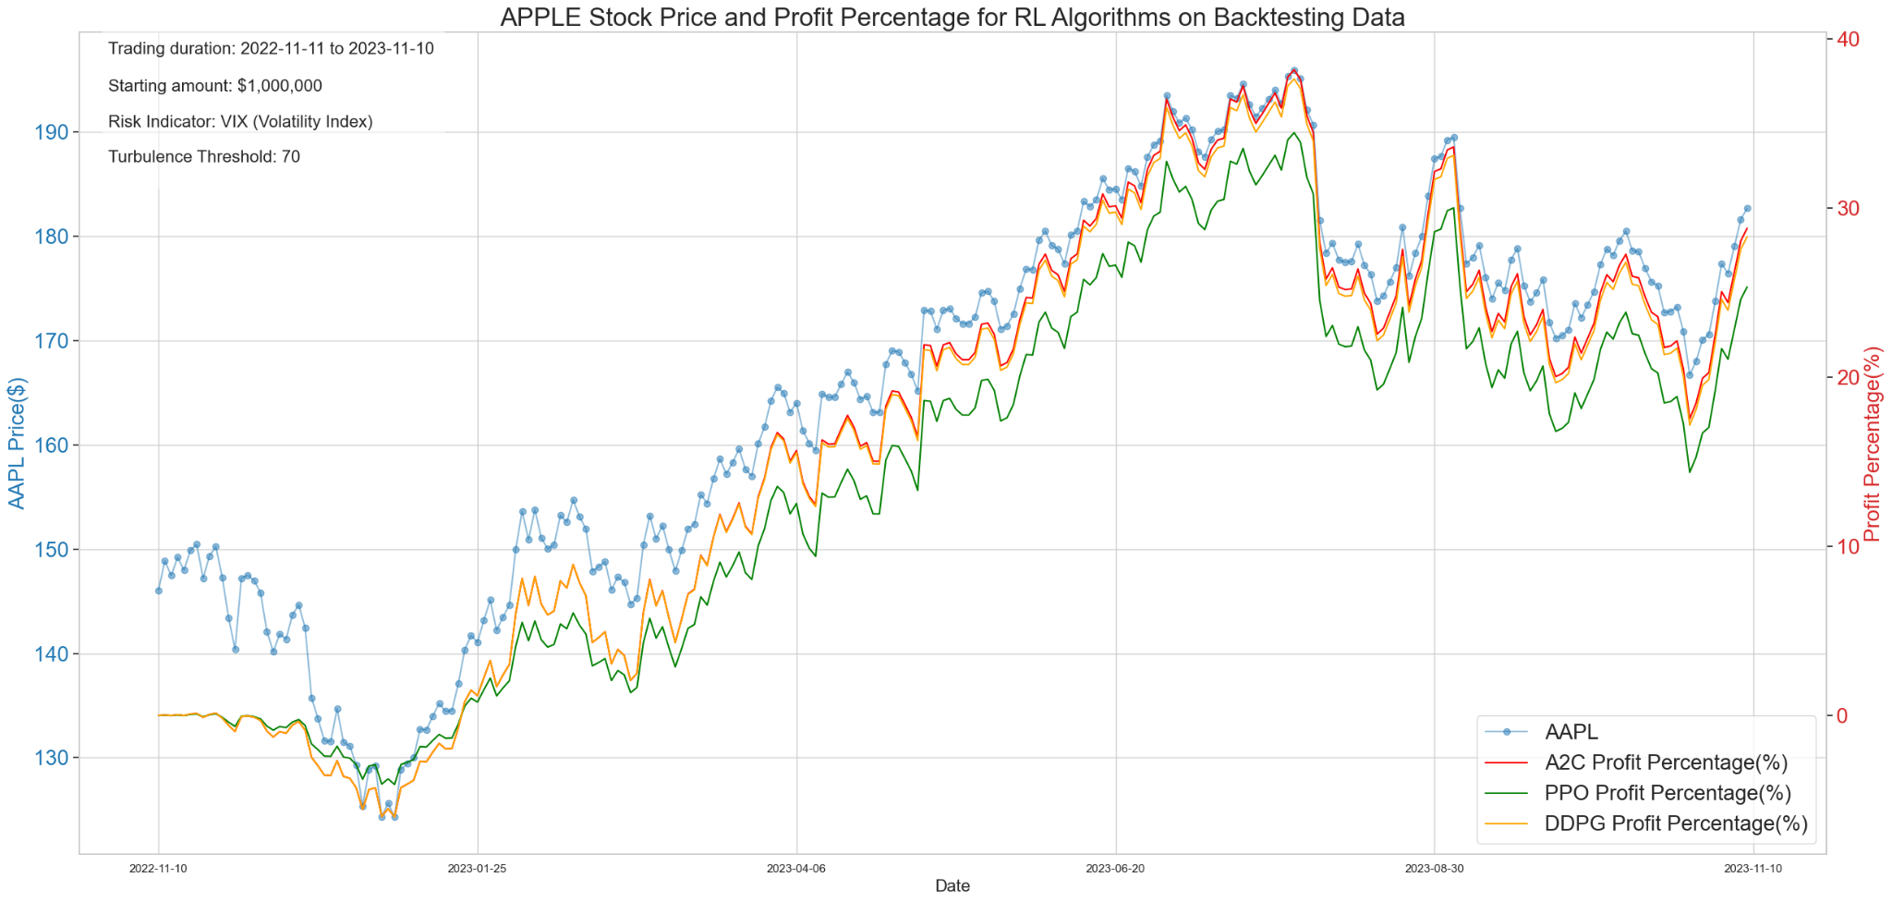
Backtest
Notes:
After training the agents with 12 years of experience of apple data, we backtest the agents on test set, which is historical data that were not used for training, which is from … to … with the same amount of money, and include risk indicator in our setup to simulate the trading env

Slide 18
Results and Key Takeaways
Reinforcement Learning Algorithms exhibit a keen ability to discern and capture trends of test data.
These algorithms excel in making accurate trading decisions.
Reinforcement Learning in single-stock trading encounters challenges, particularly in its sensitivity to the stock's volatility.
 | Annual Return
Hold Apple Stock | ~25.0%
PPO Trading | 25.3%
A2C Trading | 29.8%
DDPG Trading | 29.3%

Slide 19
Section #4: Conclusions and Future Opportunities

Slide 20
Comparison between Trading strategies (AAPL)
Trading Strategies | Annual Return (%)
Q-Learning in Custom Environment | 23.9%
DQN in Gym-Anytrading | 31.2%
A2C in Gym-Anytrading | 26.4%
PPO in FinRL | 25.3%
A2C in FinRL | 28.8%
DDPG in FinRL | 28.3%

Slide 21
Conclusions
Reinforcement Learning models have the potential to capture non-linear patterns and adapt to changing market conditions.
Preprocessing financial data and selecting relevant features are critical for performance.
Trading with Reinforcement Learning poses difficulties when dealing with volatile stocks.
Trading with ensemble agents and investment portfolio can mitigate risk.
Further hyperparameter tuning can improve the agents’ learning capability and make better decisions in trading.

Slide 22
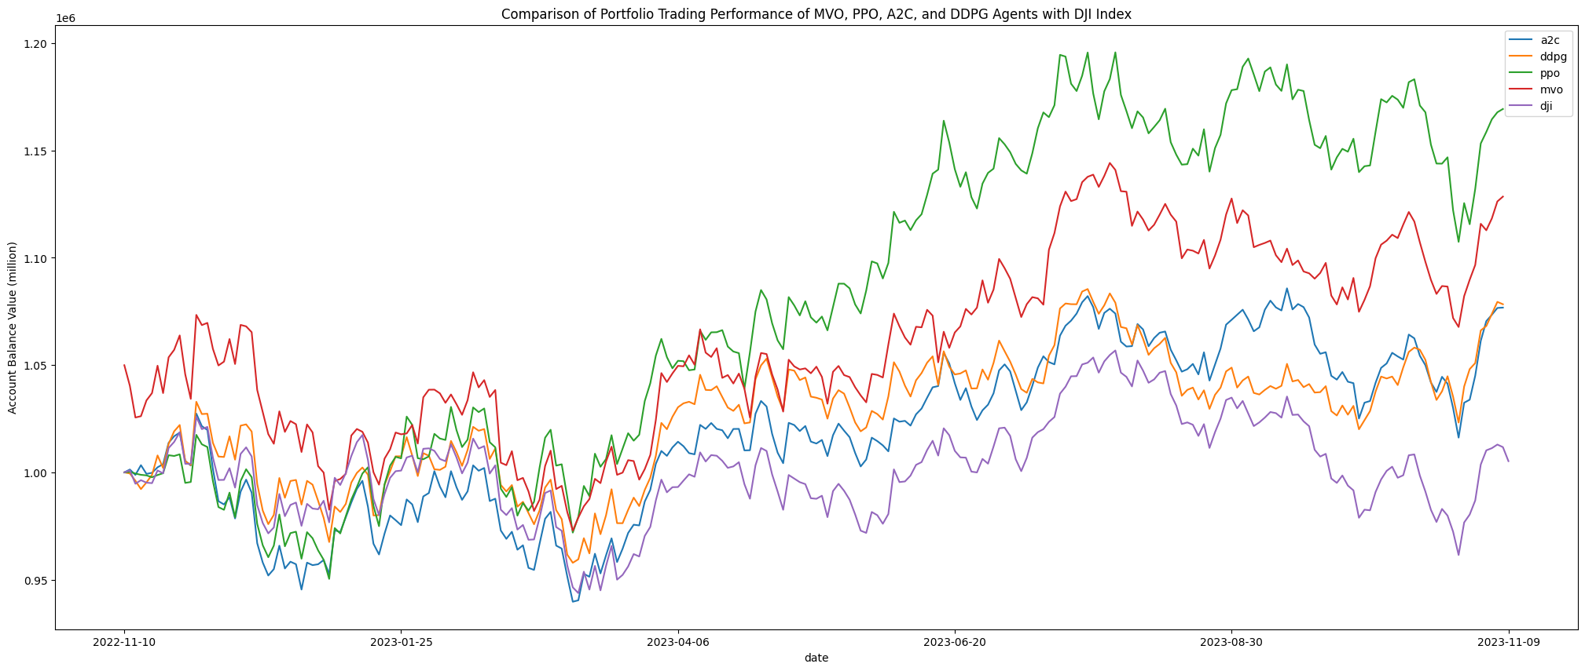
Future Opportunity:
Portfolio Trading
DJI 30 Companies
Various Industry
Trained with A2C, DDPG, PPO
Compare with traditional trading method Mean Variance Optimization
Trading Strategies | Annual Return
A2C | 7.7%
DDPG | 7.8%
PPO | 16.9%
MVO | 12.5%

Slide 23
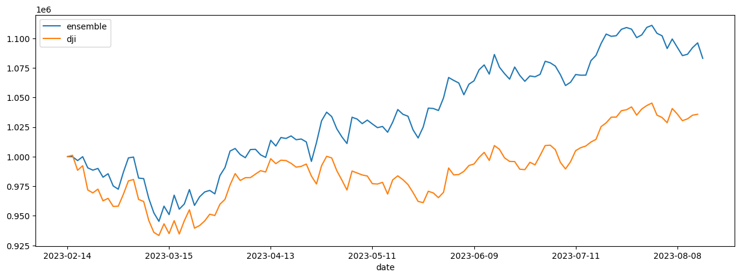
Future Opportunity: Ensemble Agents
Training and validating 3 agents (A2C, PPO, DDPG)
Rolling-window Ensemble Method
Turbulence Threshold Tuning
 | Annual Return | Sharpe Ratio
Ensemble | 17.3% | 1.309
Dow Jones | 7.4% | 0.660

Slide 24
Future Opportunity: Hyperparameter Tuning
Q-Learning (DQN)
Learning Rate: Adjusts the step size
Discount Factor: Balances the importance of immediate and future rewards.
Exploration Rate
Batch Size and Memory Size
Online-offline models update frequency
Deep Deterministic Policy Gradient (DDPG)
Actor/Critic Network Learning Rate
Discount Factor
Batch Size and Memory Size
Actor-Critic
Actor Learning Rate
Critic Learning Rate
Proximal Policy Optimization (PPO)
Learning Rate
Clip Parameter: Constrains the ratio of new and old policy probabilities.
Value Function Coefficient

